Slide 1
JAYPEE UNIVERSITY OF ENGINEERING
AND TECHNOLOGY
MINOR PROJECT -2
BATCH 19-23
Project No:- 49
Project Title:-Gesture Volume Control

Slide 2
Team Members:- Annanya Mathur (191B049)
Abhishek Dixit (191B011)
Aditya Sharma (191B021)
Project Guide :- Dr. Neelesh Kumar Jain

Slide 3
Content:-
Introduction
Use-Case Diagram
Mediapipe
Hands Landmark Detection
Palm Detection
Hand Landmarks
Implementation of Hand LandMark Detection Module
Result
References

Slide 4
Introduction
This project aims to build a functionality feature in smart devices , so that a person can increase or decrease device’s volume just by waving hands in air .This can be achieved by Computer Vision.
For this purpose we have started working over landmark detection model.
This can also be helpful to blind people.

Slide 5
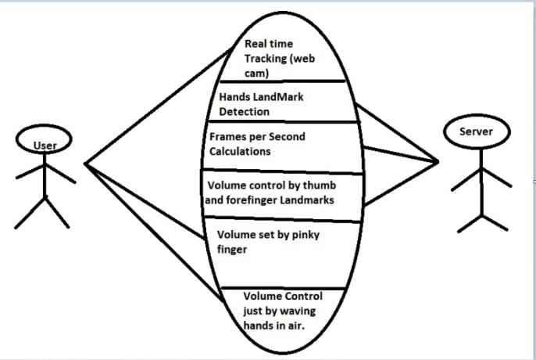
Use-Case Diagram

Slide 6
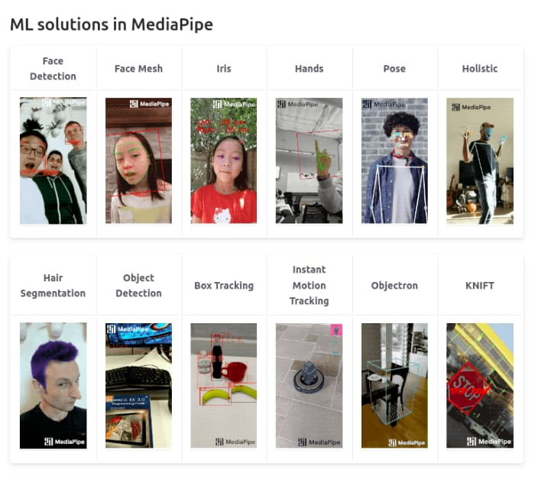
Mediapipe
Mediapipe is a cross-platform library developed by Google that provides amazing ready-to-use ML solutions for computer vision tasks.

Slide 7
Hand Tracking Module
The ability to perceive the shape and motion of hands can be a vital component in improving the user experience across a variety of technological domains and platforms.
MediaPipe Hands is a high-fidelity hand and finger tracking solution. It employs machine learning (ML) to infer 21 3D landmarks of a hand from just a single frame.

Slide 8
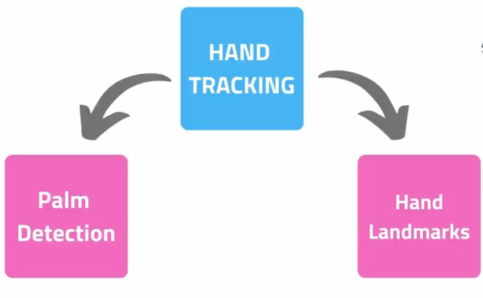

Slide 9
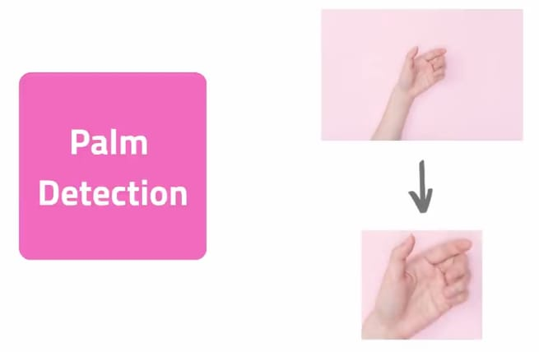
Palm Detection
Palm detection detects the hand and provide the cropped image for landmarks detection.

Slide 10
After the palm detection over the whole image our subsequent hand landmark model performs precise keypoint localization of 21 3D hand-knuckle coordinates inside the detected hand regions via regression, that is direct coordinate prediction. The model learns a consistent internal hand pose representation and is robust even to partially visible hands and self-occlusions.

Slide 11
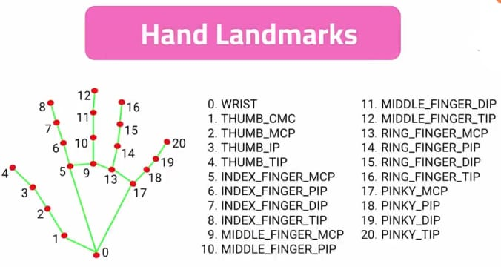
Hand Landmarks
These 21 landmarks are then detected

Slide 12

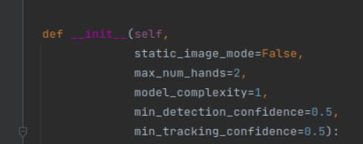
Implementation of Hand LandMark Detection Module
Header Files:-
Mediapipe has inbuilt library named “hands.py” which specifies no. of hands to be detected .

Slide 13
This function also specifies object detection confidence percentage which is 50% by default (0.5) and also object tracking confidence percentage which is also 50%
Static_image_mode:-
This function decides whether to detect or track .
If it is false , then it means it will only detect according to the confidence otherwise track.
If it is true , it will detect all the time whether hand is visible or not, this might decrease speed and accuracy.
Total Model Complexity is given by Model_Complexity which is 1

Slide 14
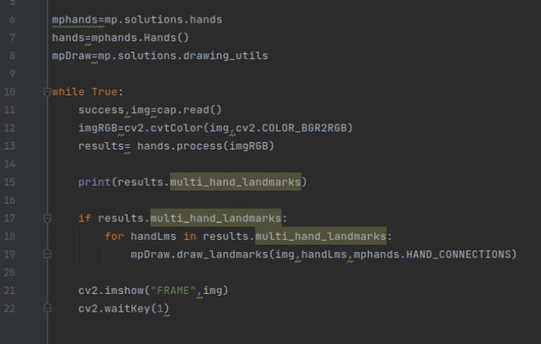

Slide 15
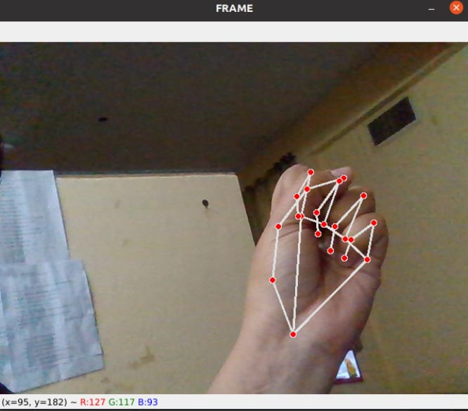
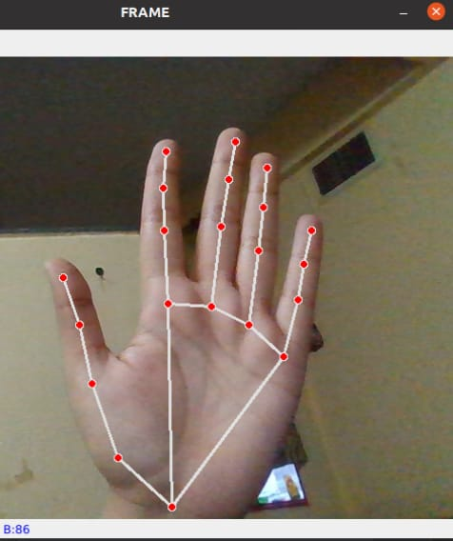
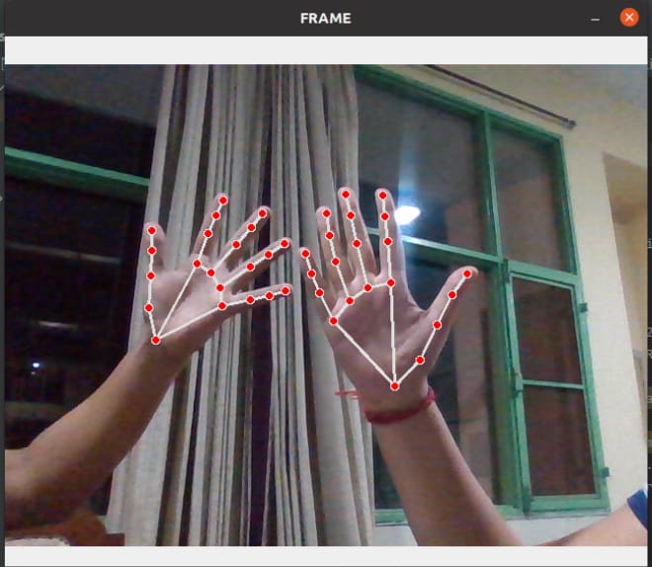
Results

Slide 16
References:-
Mediapipe Documentation: https://google.github.io/mediapipe/solutions/hands
Opencv Documentation: https://docs.opencv.org/4.x/d6/d00/tutorial_py_root.html
TextBook: Learning Opencv by Adrian Kaehler

